Slide 1
CS313 Operating Systems Lecture 13: Thread Implementation: User Level Threads, Kernel Managed Threads
Ravi Mittal
IIT Goa

Slide 2
Acknowledgements !
Contents of this class presentation has been taken from various sources. Thanks are due to the original content creators:
CS162, Operating System and Systems Programming, Profs. Natacha Crooks and Anthony D. Joseph, University of California, Berkeley
CS240 Computer Systems, Univ of Illinois, Prof. Wade Fagen-Ulmschneider
Operating Systems: Three Easy Pieces, by Remzi and Andrea Arpaci-Dusseau, available for free online
Book: Modern Operating Systems, Andrew Tenenbaum, and Herbert Bos, 4th Edition, Pearson

Slide 3
References
Book: Operating Systems: Principles and Practice: Thomas Anderson and Michael Dahlin, Part 2
CS162, Operating Systems and Systems Programming, University of California, Berkeley
CS4410, Operating Systems, Course, Cornell University, Spring 2019, Lecture on Threads
Operating Systems: Three Easy Pieces, by Remzi and Andrea Arpaci-Dusseau, available for free online

Slide 4
Read the following:
Book: Operating Systems: Principles and Practice (2nd Edition) Anderson and Dahlin
Volume 2, Concurrency
Chapter 4: Concurrency and Threads
Book: Modern Operating Systems: Tenenbaum and Bos
Chapter 2: Processes and Threads

Slide 5
We will study..
User Space Thread and Kernel Space Threads
Thread Library - Introduction

Slide 6
Recall: Thread
A thread is a single execution stream in a process which can be independently scheduled by the kernel and shares the same addressable space with any other thread.

Slide 7
Recall: Thread and Concurrency
Operations are concurrent if they may be arbitrarily interleaved so that they make progress independently
Threads can be scheduled to use the CPU in any order with any other thread
A thread may be removed from the CPU at any point of execution and replaced by another thread
Operations which cause one thread to suspend execution do not cause the execution of other threads to be suspended
If the order that threads execute matter, or a thread must fully complete a task before other threads can execute, then the thread execution must be synchronized to coordinate action

Slide 8
Recall: Thread’s addressable Memory
Any data whose address may be determined by a thread are accessible to all threads in the process
This includes static variables, automatic variables, and storage obtained via malloc
This does not mean that a thread cannot have private data
POSIX includes a way for a thread to have data which only it can access

Slide 9
Problems of Multithreaded Programs
Computational overhead of thread synchronization and scheduling overhead, which may be intolerable on programs with little parallelism
So, poorly programmed multithreading may take more time
Greater programming discipline to plan and coordinate different execution sequences
Bad code breaks in ways that can be very hard to locate and repair

Slide 10
User Space Thread and Kernel Space Thread

Slide 11
User Threads, Kernel Threads
There are two main places to implement threads
User Space
Kernel Space

Slide 12
User thread - Concept
Implement thread package entirely in user space
All thread management is done by the application
Kernel knows nothing about it – it continues to manage ordinary single threaded process
Advantage:
A user-level thread package can be implemented on an OS that doesn’t support threads
Most old generation Operating systems didn’t support threads
Hence, threads were implemented by a library

Slide 13
User Thread - Concept
Implement thread creation/scheduling using procedure calls to a user-level library rather than system calls
User-level library implementations of thread_create(), thread_yield(), etc.
User level library performs same set of actions as corresponding system calls, but thread management is controlled by user-level library
The entity created by the library to implement the POSIX specification is called a user thread
Examples: Mach C-threads, BSD, Solaris UI-threads and DCE-threads.

Slide 14
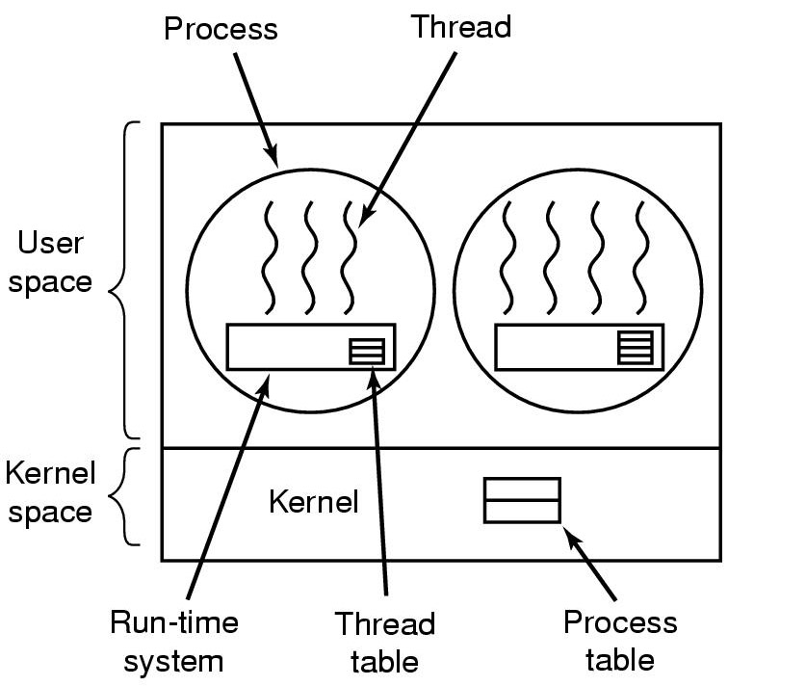
Implementing Thread in User Space (1)
Threads run on top of run-time system
Collection of procedures to manage threads
Each process needs own private thread table (Thread control Block)

Slide 15
Implementing Thread in User Space (2)
Thread Table (or Thread Control Block)
Keeps track of the threads in the process
Per thread properties: PC, SP, registers, state, etc
Thread table is managed by runtime system
When a thread moves to ready state or blocked state, the information required to restart it is stored in Thread table (or TCB)
If a running thread may become locally blocked
Eg. Waiting for another thread (in the same process) to complete some work
It calls for run-time system procedure
The procedure checks if the thread must be put into blocked state. If so, it stores threads state into the table (TCB)
It re-starts a ready thread by loading it’s registers from the thread’s table or TCB

Slide 16
Advantages of User space threads
In machines, processor supports
an instruction to store all registers
Another instruction to load them all
Thread switch can be done with a few instructions
Thread switching is very fast compared to use of kernel trappings for switching
A thread may run thread_yield
The code for thread_yield saves thread state into the table/TCB and calls scheduler to pick up another thread
Local procedures – more efficient than making a kernel call
No trap is required – no context switch (by Kernel) is required
Makes scheduling very fast

Slide 17
Advantages of User space threads
Each process can have its own customized scheduling algorithm
Easy garbage collection by garbage collection threads
Overall better scaling – large number of threads

Slide 18
Disadvantages of User level threads
Blocking System call implementation
A thread making a syscall can block all threads
One solution is to make many syscalls non-blocking
A page fault by a thread – entire process (all threads including) will be blocked
If a thread starts running, there is no way to stop it
Unless OS moves the process out
Or thread voluntarily exits
Cannot take advantage of multiprocessor architecture
Why?

Slide 19
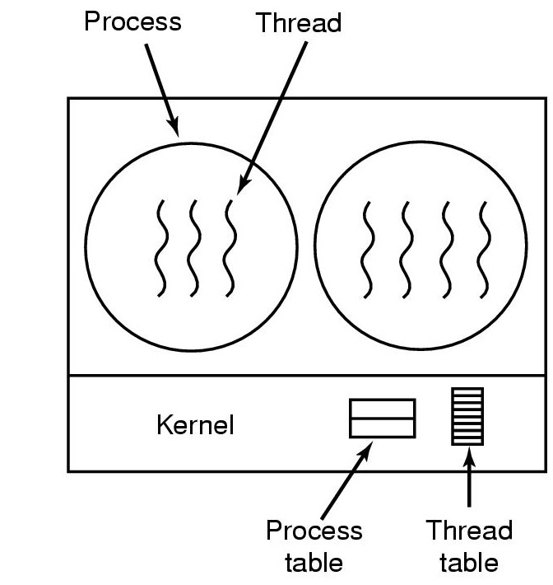
Thread Management in Kernel (1)
Kernel knows how to manage threads in a user process
No run-time system required
No thread table in each process
When a thread wants to create a new thread or destroy an existing thread, it makes a system call
Kernel creates or destroys thread as per request.
Updates kernel thread table
(PCBs)
(TCBs)

Slide 20
Thread Management in Kernel (2)
All calls that might block the thread are implemented as system call
When a thread blocks, the kernel can run another thread
From the same process or
different process
Advantages:
Can take full advantage of multiprocessor architecture within a single process
Disadvantages:
Poor scaling when many threads are used, as each thread takes kernel resources from the system
Generally, slow thread context switches since these require the kernel to intervene.

Slide 21
Kernel Managed Threads
Examples:
Windows operating system and Linux Threads
Kernel managed threads: Some authors call these as Kernel threads (we use the term: Kernel managed threads)

Slide 22
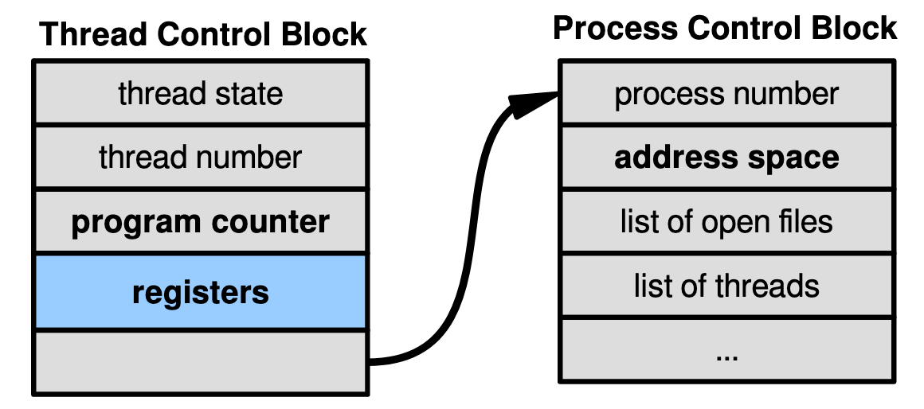
Thread Management in Kernel (3)
Each thread has a thread control block
CPU registers, including PC, pointer to stack
Scheduling info: priority, etc.
Pointer to Process control block
OS scheduler uses TCBs, not PCBs

Slide 23
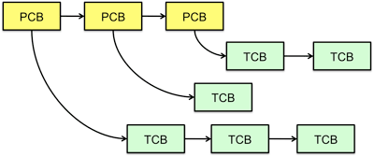
Thread Management in Kernel (4)
Kernel’s Thread table/TCB implementation is kernel dependent
Thread Table/TCB holds register values, PC, etc
Kept in kernel space
Information about each process is kept in Process Table/PCB
Kernel Space
Other implementations are also possible

Slide 24
Kernel Threads
Threads created by kernel for Kernel Processes (Using Kernel code)
A kernel thread executes kernel code and modifies kernel data structures

Slide 25
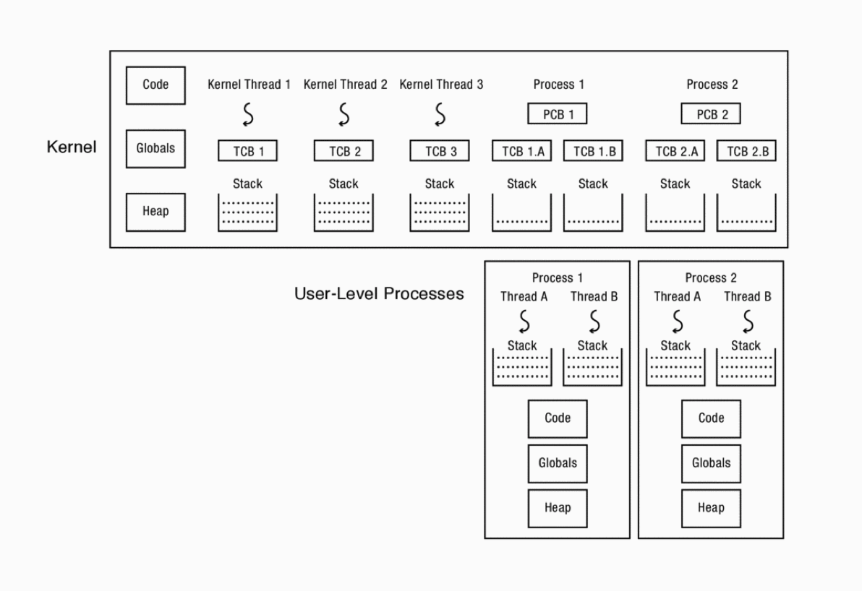
Thread Management in Kernel (4)
Three Kernel threads and
Two user level processes – each process with two threads
Each user thread has a user stack for executing code and a Kernel (interrupt) stack executing interrupts and system calls
Thread management is done in Kernel

Slide 26
Thread Management: User level /Kernel level
A Thread can be scheduled separately by a scheduling algorithm; Eg running only third thread
A Thread be blocked without blocking other threads; ex: Only second thread is blocked
Management at user level
Management at Kernel level
Process
Process
OS
Threads can run on different CPUs
Good from perf perspective
Bad from management perspective

Slide 27
Thread Execution

Slide 28
Correctness with Concurrent Threads
Non-determinism:
Scheduler can run threads in any order
Scheduler can switch threads at any time
This can make testing very difficult
Independent Threads:
No state shared with other threads
Deterministic, reproducible conditions
Cooperating Threads:
Shared state between multiple threads
Goal: Correctness by Design
Prof. John Kubiatowicz, CS 162, Operating Systems, UCB

Slide 29
Race Conditions
Initially x == 0 and y == 0
What are the possible values of x below after all threads finish?
Must be 1. Thread B does not interfere
Thread A
x = 1;
Thread B
y = 2;
Prof. John Kubiatowicz, CS 162, Operating Systems, UCB

Slide 30
Race Conditions
Initially x == 0 and y == 0
What are the possible values of x below?
1 or 3 or 5 (non-deterministically)
Race Condition: Thread A races against Thread B!
Thread A
x = y + 1;
Thread B
y = 2;
y = y * 2;
Prof. John Kubiatowicz, CS 162, Operating Systems, UCB

Slide 31
Example 2: Parallelization (self reading)
Consider the following code segment:
for (k = 0; k < n; k++)
a[k] = b[k] × c[k] + d[k] × e[k]
Is there a missed opportunity here?
thread_create(T1, fn, 0, n/2) thread_create(T2, fn, n/2, n)
fn(l,m) {
for (k = l; k < m; k++)
a[k] = b[k] × c[k] + d[k] × e[k]
}

Slide 32
Example : Web Server (self reading)
Consider a Web server
get network message from client
get URL data from disk
compose response
send response

Slide 33
Example 3: Web Server (self reading)
Consider a Web server
Create a number of threads, and for each do
get network message from client
get URL data from disk
compose response
send response
What did we gain?

Slide 34
Example 3: Web Server - Overlapping I/O and Computation (self reading)
Request 1
Thread 1
get network message (URL) from client
get URL from disk
(disk access latency)
send data over network
Request 2
Thread 2
get network message (URL) from client
get URL from disk
(disk access latency)
send data over network
Time
Total time is less than Request1 + Request 2 done separately

Slide 35
Multithreaded Programs
You know how to compile a C program and run the executable
This creates a process that is executing that program
Initially, this new process has one thread in its own address space
With code, globals, etc. as specified in the executable
Q: How can we make a multithreaded process?
A: Once the process starts, it issues system calls to create new threads
These new threads are part of the process: they share its address space
Prof. John Kubiatowicz, CS 162, Operating Systems, UCB

Slide 36
Thread Management
Threads are identified by a process unique thread ID
When threads are created they begin executing a function, whose parameter is passed during creation
Compare process creation with fork and exec, when an argument list is passed
Threads can exit or be terminated by other threads
A thread can wait for another thread and collect its return value
Threads have modifiable attributes like priority

Slide 37
Thread Libraries
Three main Thread Libraries in use today
POSIX Pthread
User or Kernel level
Windows
Kernel-level
Java
Using Windows APIs
Linux, Unix, MacOS
Pthreads

Slide 38
Thread Operations in general
thread_create(thread, func, args)
Create a new thread to run func(args)
In some OS: thread_fork
thread_yield()
Relinquish processor voluntarily
thread_join(thread)
In parent, wait for forked thread to exit, then return
thread_exit
Quit thread and clean up, wake up joiner if any
Notes:
UNIX fork and thread fork are not the same thing

Slide 39
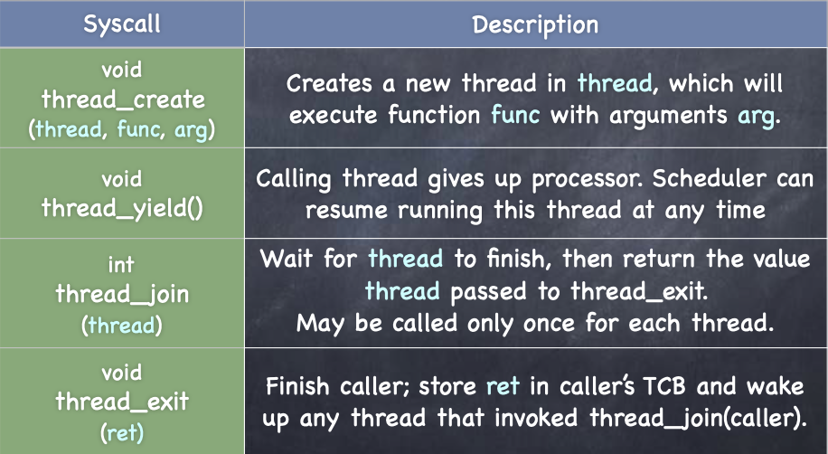
A Simple API

Slide 40
Fork-Join Pattern
create
exit
join
Main thread creates (forks) collection of sub-threads passing them args to work on, joins with them, collecting results.

Slide 41
Lecture Summary
Threads abstraction gives illusion of infinite number of processors
User level threads can be managed at user level by run-time system
User level threads can also be managed at Kernel level
Popular
Concurrent execution of thread (of a process) may lead to
Non-determinism
Thread operations include
Thread_create, thread_yield, thread_join, thread_exit
Multithreading model defines
User level threads
Kernel level threads

Slide 42
Thread Library: pthread

Slide 43
What are pthreads?
POSIX standard IEEE 1003.1c defines a thread interface
pthreads
Unix/Linux provides pthread library
APIs to create and manage threads
Implementation is up to development of the library
Simply a collection of C functions
Standard interface for ~60 functions that manipulate threads from C programs
Primary way of doing threading in Linux is pthread
Since 2003 (Kernel 2.6), Linux implements POSIX threads as kernel-scheduled threads

Slide 44
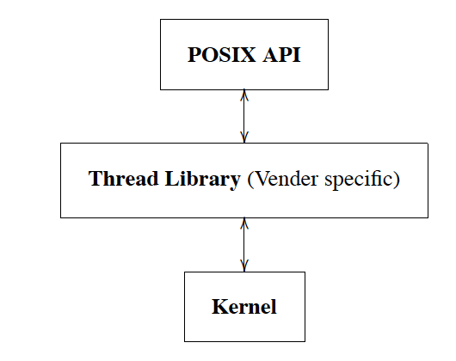
Thread Implementation: Layers of Abstraction

Slide 45
POSIX Library Implementation (F. Mueller’s Paper)
Language Application
Language Interface
C Language Application
Posix thread library
Unix libraries
User Level
Unix Kernel
Kernel Level

